Slide 1


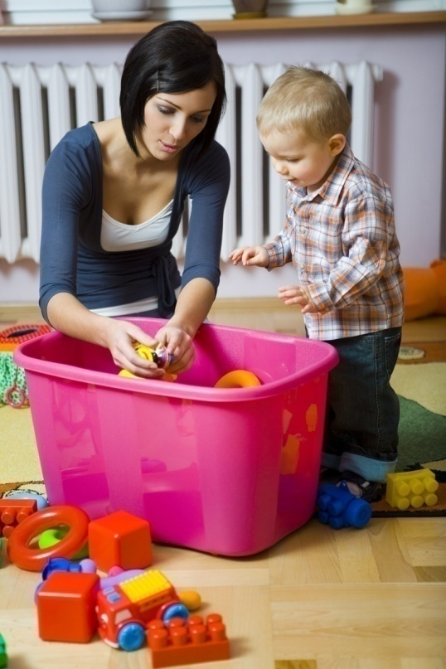

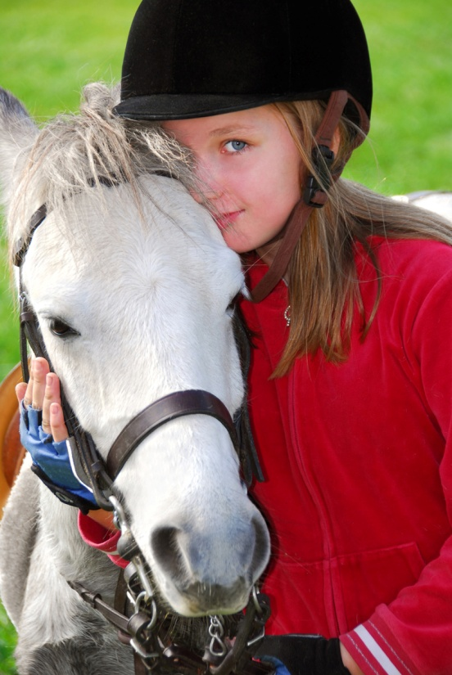
Social –
Emotional
Development

Slide 2
General Emotional Patterns 4-6 year olds:
Meet new people – can change behaviors
More responsibility – greater independence
4 year olds (negative): (Positive):
  Self-centered * Loving and affectionate
  Impatient * Want parental approval
  Defiant – NO * Like to make people laugh
  Bossy * Trying to be independent
  “Turn on a dime”
  Name-calling, making fun or
  playing with someone’s name sounds

Slide 3
General Emotional Patterns - continued
5 year olds (Positive):
  Practical -- Serious
  Sympathetic --Conscientious
  Mindful of parents/teachers --More realistic
  Conform to rules easily
  (Negative):
  Anxious
  Can be too eager to please

Slide 4
General Emotional Patterns cont.
6 year olds (Positive):
  Appreciate humor more
  Stronger emotions
  Crave praise
  (Negative):
  Stubborn
  Quarrelsome, argumentative
  Rapidly changing moods, again
  “Know-it-all”, resent directions
  Easily hurt and discouraged

Slide 5
Specific Emotions
Self-confidence – when successful child’s confidence improves
  Develop INITIATIVE – motivation to do more.
  Anger –
    At 4: Show physically, lasts longer, may threaten others to “get even”
    At 5: Want to hurt feelings of others more than physical hurt.
    At 6: Tease, insult, nag, make fun – more wordy

Slide 6
Specific Emotions - continued
Anger – continued
  Frequency decreases, but anger lasts longer in this age.
  Tolerance for frustration increases a little with age.
  May try to punish authority figure for being punished.
  How do deal:
  Have more social interactions to learn how to handle different situations or practice social situations to prevent angry feelings
  Accept that things belong to others, not just themselves Teach respect for others’ belongings
  Set an example for how to handle anger appropriately
  Encourage use of words to describe feelings rather than the physical expression

Slide 7
Specific Emotions cont.
Fear–
  Well-developed imagination – imaginary dangers
    Ghosts, robbers, monsters, kidnappers, vampires…
  Children may also fear school – afraid to leave security of home/family.
  School itself may be a fear - leaving home
  Being abandoned by caregiver
How do deal:
  Accept the fear – it’s very real for the child, don’t blow it off.
  Listen without ridicule – Children won’t trust you if you make them feel badly about the fear.
  Face the fear – practice how to handle the situation before it happens.
    Pet a toy dog before the real thing
    Look under the bed/in the closet in daylight before doing it at night.

Slide 8
Specific Emotions cont.
Jealousy–
  Sibling rivalry
    Very common
    Tattling on sibling
    Comparisons are rarely helpful, often hurtful to a child
How do deal:
  Don’t compare children at home or in the classroom
  Teach empathy
  A little extra attention, for each child, separately is good, have a special activity for different children

Slide 9
Stress
Stress is everywhere for every age!!! Learn to look for signs of stress:
  Nail-biting --Trouble sleeping
  Moodiness --Trouble in school
  Headaches --Pulling away/Being clingy
  Any difference in child’s behavioral pattern
  Hug, listen, teach/model how to handle stress
    Find the cause of the stress --Read a book about stress
    Teach ways to relieve stress --Follow up on children
    Maintain normal limits on behaviors.

Slide 10

Competition
Good:
  Stimulates higher standards
  Highlights individual achievement
  Gains realistic view of abilities
  Helps children excel
  Encourages speed
  Bad:
  Success depends on ability to “out-do” others
  Leads to hostile relationships
  Results in lack of effort in those who don’t usually win
  Points out children’s inadequacies
  Lowers status/self-esteem of those to lose

Slide 11
General Emotional
Patterns 7-12 year olds:
Developing a sense of self:
  Children develop their personality and know they are unique.
  See themselves as a mixture of traits and qualities
  Can recognize own skills and abilities.
  Realize they behave differently in different situations.
  Know that others perceive them differently than they do. Point of view.
Gender Identity:
  Differences between being a boy or girl.
  Role models.
  Interest in opposite sex

Slide 12

Middle Childhood – Emotional Changes
A sense of self:
  Beginning to think abstractly
  Trying to figure out who they are and will become
  Finding out unique characteristics about self
  Discovering talents
  Seeing different behaviors in different situations, roles and their expectations
  Seeing how others perceive them, different points of view

Slide 13
Middle Childhood – Emotional Changes continued
Being male or female:
  Gender Identity – what girls/boys do/have
  Spend more time with same gender
  Desire to behave like others of same gender
  Identify ROLE MODELS
  Begin exploring relationships with opposite gender

Slide 14
Middle Childhood – Emotional Changes continued
Age 7: withdrawn, quiet, worry-warts sensitive, prefer to be near home
Age 8: more outgoing, want to explore, dramatic, lively, positive view, tend to exaggerate
Age 9: harsh toward self and failing, tense, concentrated
Age 10: positive, happy, enjoying everything

Slide 15
Middle Childhood – Emotional Changes continued
Early Adolescence:
  HORMONES!!!!!!!!!!!! Puberty sends hormones into overdrive
  Mood swings – look out, they’re quick and intense
  Self-absorbed – pay attention to self and peers
  Often hide true feelings – seem not to care
  Emotional control is developing – somewhat

Slide 16
Middle Childhood –
Specific Emotions
Anger:
  Boil over and fade quickly
  Anger action is usually not reacting to immediate situation, but something prior and peer related
  Can use words much better to express problems
  Setting a good example is the best way to teach how to handle anger and frustration
  Show how to handle without violence or physical ration of any kind
  Rewards can be appropriate to help train

Slide 17
Middle Childhood –
Specific Emotions cont.
Fear & Worry:
  Fears still exist, may interfere with sleep
  New worries show up, more severe that the dark – car accidents, death
    Usually in response to what happens in family or peer group
    Concern for how others view them
    Still peer focuses – their opinions matter more

Slide 18
Living with children 7-12
4 helpful hints for dealing with children in this age are:
  1. Be Patient!! – this is a difficult time, they need to learn how to deal with all the changes.
  2. Don’t take it personally – It’s a phase, it will pass, they don’t usually mean what they say.
  3. Keep the child under control – Don’t allow for inappropriate behavior, explain what’s appropriate
  4. LISTEN – Kids usually want to talk, let them, it doesn’t mean you agree with them, but show how to handle it.

Slide 19

Social and Moral Development 7-12
Children value friends who are loyal, comfortable, and fun
Puberty affects friendships – kids want to talk to kids
Relate deeper to others – empathy
Tend to keep more friends of the same gender, even though they may be interested in the opposite gender

Slide 20
Social and Moral Development 7-12 continued
Number of friends varies, no right number
Do you have the friendships you WANT to have? Do you value yourself by the NUMBER of friends you have?
Peer Pressure – adopting words, behaviors, habits of peer group to fit in
  Can be VERY powerful, both positively and negatively.
  Conformity – adopting words, behaviors, habits of peer group to fit in, avoid ridicule
  Joking, teasing – very hurtful, damaging

Slide 21
Social and Moral Development 7-12 continued
Family relationships change and grow
Family time, rules and boundaries are still needed
Changes in feelings toward parents:
  7s – depend on parents, but challenge parents’ rules
  8s – cling to parents
  9s – self-centered, ignore parents more
  10s – usually smooth-sailing
  11/12s – can be critical, more questioning and development of thought
  12s – more cooperative
  Late teens – usually return to respecting parents, understanding why rules are important

Slide 22
Social and Moral Development 7-12 continued
Moral Development: Observe morals of others and have to start to decide more for themselves
  Set good examples of moral behavior: “Do as I say AND do”
  Support a child’s conscious development – “inner Jimminy Cricket”
  Discuss possible situations/outcomes include examples for your past, if appropriate
  Reinforce and model empathy – how would you feel if that happened to you???
  Fairness matters – use that to explain situations

